Slide 1
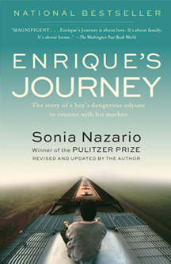
Mining Books
Discussion Co-Led by Drs. Isabel Baca and R. Joseph Rodríguez
Department of English
April 28, 2015

Slide 2
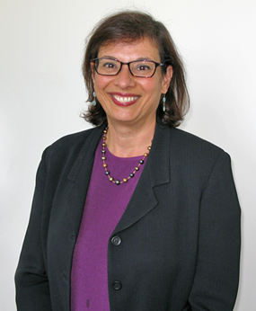
Meet Sonia Nazario
Nazario is an award-winning journalist whose stories have tackled some of this country’s most intractable problems — hunger, drug addiction, immigration — and have won some of the most prestigious journalism and book awards.
A fluent Spanish speaker of Jewish ancestry whose personal history includes living in Argentina during the so-called dirty war, Nazario has spent 20 years reporting and writing about social issues for U.S. newspapers.

Slide 3
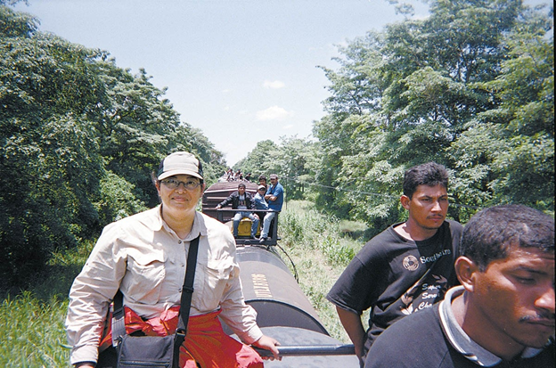
Journalist in Action
Nazario is atop El Tren de la Muerte (The Train of Death) as it traverses the length of México for nearly a 1,450-mile journey.
This freight train line is also known as La Bestia (The Beast) and El Tren de los Desconocidos (The Train of the Unknowns).

Slide 4
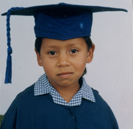
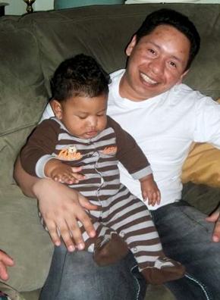
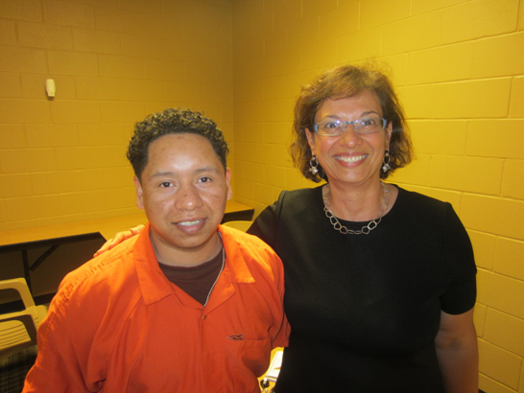
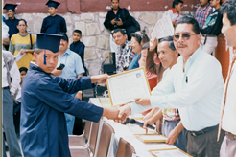
Meet Enrique

Slide 5
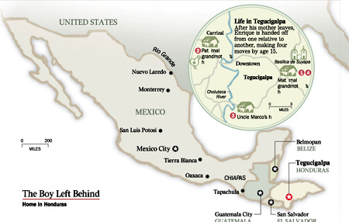
The Journey

Slide 6
Selected Quotes (I)
“Sometimes the most powerful stories are simply told.”
—Sonia Nazario (2014)
“Dame pico, mami. Give me a kiss, mom.”
(Nazario 3)
Enrique marks his sixteenth birthday. All he wants is his mother. One Sunday, he and his friend José put train riding to the test. They leave for el Norte. (Nazario 37)
“Grandma, I’m leaving.” Enrique says. “I’m going to find my mom.”
(Nazario 43)

Slide 7
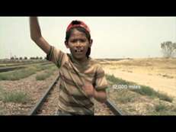
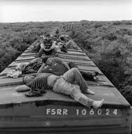
Selected Quotes (II)
The mothers share the same fears: Will their children forget them?
Will they see their children again. (Nazario 155)
Enrique flares and begins to pack. Enrique says [to his mother Lourdes],
“Who are you to me? I don’t even know you.” (Nazario 195)
“Always remember one of our first instincts should be compassion,
to put ourselves in other people’s shoes.”
—Sonia Nazario (2014)

Slide 8
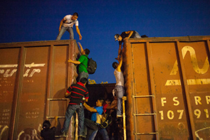
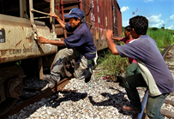
Selected Quotes (III)
“¡Allí va uno! There’s one!”
Enrique looks down [from the train he’s riding]. There are the same woman and boy. They are heaving a blue plastic bag. This time the bundle lands squarely in his arms. “¡Gracias! ¡Adiós!” He calls into the darkness. He isn’t sure the strangers, who pass by in a flash, even heard him.
He opens the bag. Inside are half a dozen rolls of bread.
(Nazario 104)

Slide 9
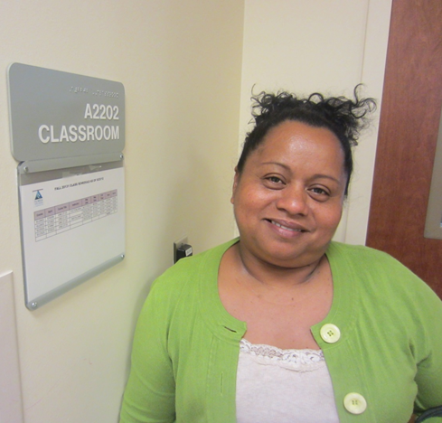
Meet Lourdes
Lourdes, Enrique’s mother, stands outside a college classroom in Jacksonville, Florida, where she studies. (2013)

Slide 10
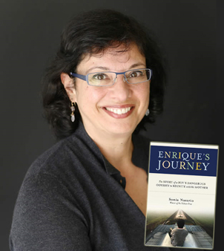
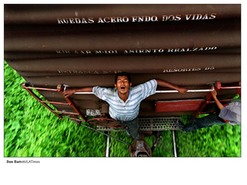
Authors on Enrique’s Journey
“This is a twenty-first-century Odyssey. Nazario’s powerful writing illuminates one of the darkest stories in our country. This is outstanding journalism.
If you are going to read only one non-fiction book this year,
it has to be this one, because you know these young heroes.
They live next door.”
—Isabel Allende

Slide 11
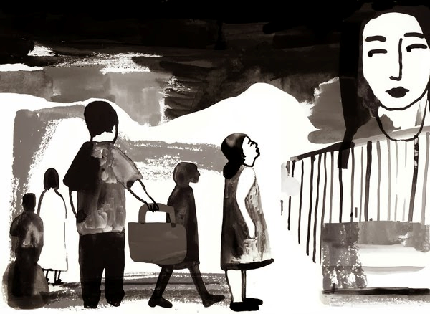
The Heartache of an Immigrant Family
Art by Sarah Williamson
The New York Times
14 October 2013

Slide 12
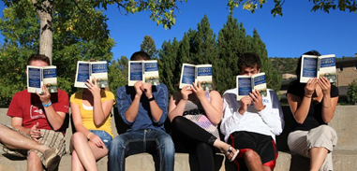
Works Cited
Johnson, Philip. “Sonia Nazario Believes It’s an Educator’s Role to Expand Students’ Horizons.” The Council Chronicle 24.2 (2014): 10-11. Print.
Nazario, Sonia. Enrique’s Journey. Web. 26 March 2015.http://www.enriquesjourney.com
Nazario, Sonia. Enrique’s Journey. New York: Random House, 2014. Print.
Nazario, Sonia. Enrique’s Journey: The True Story of a Boy Determined to Reunite with His Mother, Adapted for Young People. New York: Ember, 2013. Print.
Nazario, Sonia. “The Heartache of an Immigrant Family.” The New York Times.14 Oct. 2013. Web. 26 March 2015.

Slide 13
El día de los niños / El día de los libros
Founded by the author Pat Mora, El día de los niños / El día de los libros (Children’s Day / Book Day) is a year-long commitment to linking children and families to books.
The initiative celebrates the importance of bookjoy in young people’s daily lives.

Slide 14
Acknowledgements
We thank the following generous supporters of Mining Books . . .
Drs. Maggy Smith and Brian Yothers
UTEP Department of English
UTEP Library
UTEP Office of University Communications
El Paso Times
Book Donors
Books Are Gems

